Slide 1
AI WORKSHOP
PYTHON

Slide 2
What are the basic Data Structures in Python?

Slide 3
LISTS
It is a data type that stores a collection of data by storing several values in a single variable.
They are mutable(i.e. We can make any change in list),ordered,can be nested,allows duplicate elements.
Lists are used to store data that needs tampering regularly, i.e. adding,changing or deleting elements from the list
Elements in lists can be accessed easily using indexing.

Slide 4
What do I do if I want to make sure the data is unchanged?

Slide 5
TUPLE
A Tuple is a collection of Python objects separated by commas. In some ways, a tuple is similar to a list in terms of indexing, nested objects.
However unlike lists tuples are immutable i.e. We cannot add,change or delete data from the tuple.
We can however convert a tuple to a list, modify the list and convert it back to tuple.
Tuples can be used to store data which is not meant to be changed, as tuples prevent any accidental deletion or insertion of elements in the tuple.

Slide 6
Sets
A Set is an unordered collection data type that is iterable, mutable, and has no duplicate elements.
Sets are unordered thus we cannot access the elements using indexing or a key.However you can iterate over elements.
Sets elements cannot be changed but you can delete and add elements into the set as long as there are no duplicates in the set.
Python’s set class represents the mathematical notion of a set.
Why do we use sets?
Notes:
Sets are useful when you want to perform mathematical operations such as union,intersection etc on the collection of data available

Slide 7
DICTIONARIES
Dictionary is an ordered collection of data values, used to store data values like a map, which, unlike other Data Types that hold only a single value as an element, Dictionary holds key:value pair to make it more optimized
The keys of dictionaries must be immutable ,ex: Int,str,float,boolean….
Dictionaries are mutable as long as keys are not duplicated.
Dictionaries can be indexed using the keys to obtain the respective values.
Why do we use dictionaries?
Notes:
dictionaries allow us to associate a value to a unique key, and then to quickly access this value. It’s a good idea to use them whenever we want to find (lookup for) a certain Python object. We can also use lists for this scope, but they are much slower than dictionaries.

Slide 8
FUNCTIONS
How does functions help?

Slide 9
FUNCTIONS : MOTIVATION
Use same piece of code to run multiple times
Easy to write, read etc

Slide 10
FUNCTIONS
ARGUMENTS
FUNCTION CALL
def myfunction():
#statements
def add(a,b):
sum=a+b
return sum
myfunction()
add(1,2)

Slide 11
Functions inside a Function
def outerFunction(text):
text = text
def innerFunction():
print(text)
innerFunction()
Can we access innerFunction by any chance ?

Slide 12
RECURSION
A complicated function can be split down into smaller sub-problems utilizing recursion.
def fact(n):
if n == 0:
return 1
else:
return n * fact(n-1)

Slide 13
CLASSES
Why do we need Classes ?

Slide 14
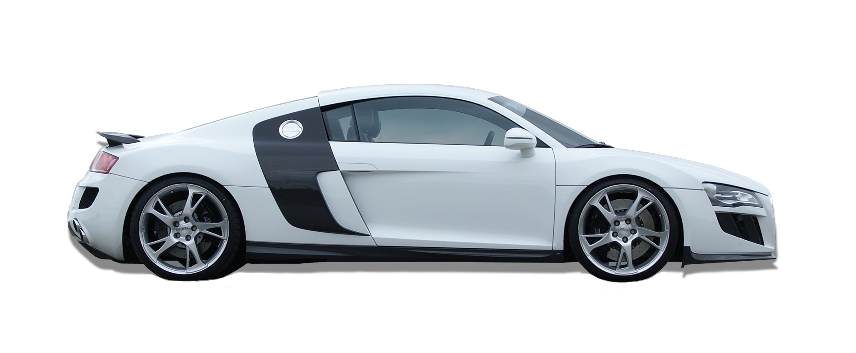
CLASSES & OBJECTS
ATTRIBUTES
NAME
COLOR
PRICE
METHODS
ACCELERATE
CHANGE GEAR
APPLY BRAKE
CAR
OBJECT

Slide 15
CLASSES : MOTIVATION
Faster and easier to execute
Reusable code
Easy to maintain , modify , debug

Slide 16
CLASSES
class Car:
def __init__(self,name,color,price):
self.name = name
self.color = color
self.price =price
def brake(self):
self.speed=0
print("Car Stopped")
Blueprint for creating objects.

Slide 17
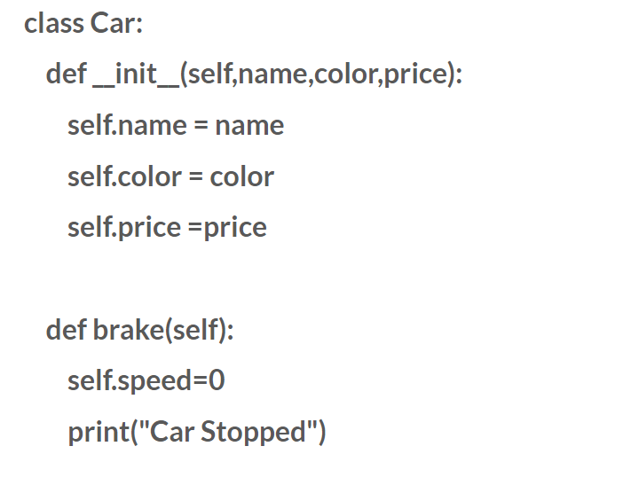
__init__()
Assign values to object properties
The function is called automatically every time the class is being used to create a new object.

Slide 18
self Parameter
Refers to the current object of the class.
Used to access variables that belongs to the class.
Has to be the first parameter of any function in the class.

Slide 19
OBJECT (INSTANCE)
Create object
car1 = Car ( “ABC” , “WHITE” , 1000)
Access attributes
print ( car1.color )
Access member functions
car1.brake()

Slide 20
Modify object Properties
Delete object Property
Delete object
car1.color = “Red”
del car1.color
del car1

Slide 21
THANK YOU

Slide 22
RESOURCES
https://www.w3schools.com/python/

